Slide 1
Employee Data Analysis using Excel
STUDENT NAME: ANITA .R
REGISTERNO : 312211014 ,asunm1423312211014
DEPARTMENT : DEPARTMENT OF COMMERCE B.COM (GENERAL)
COLLEGE : DR.MGR JANAKI COLLEGE OF ARTSAND SCIENCE FOR WOMEN

Slide 2
EMPLOYEE PERFORMANCE ANALYSIS USING EXCEL
PROJECT TITLE

Slide 3
AGENDA
◆Project Overview
◆Problem Statement
◆End Users
◆Our Solution and Proposition
◆Dataset Description
◆Modelling Approach
◆Results and Discussion
◆Conclusion

Slide 4
PROBLEM STATEMENT
IDENTIFYING STRENGTHSANDWEAKNESSES: Understand individual skills and areas for improvement.
SETTING GOALSAND EXPECTATIONS: Establish clear objectives and targets.
EVALUATING JOB FIT: Determine if employees are suited for their roles.
DEVELOPMENTAND GROWTH: Create training plans and opportunities for advancement.
PERFORMANCE IMPROVEMENT:Address underperformance and provide support.
FAIR COMPENSATIONAND REWARDS: Base salary and benefits on performance
SUCCESSION PLANNING: Identify future leaders and key players.
ENHANCING EMPLOYEE ENGAGEMENT: Recognize and value contributions.
STRATEGIC DECISION-MAKING: Inform business decisions with data-driven insights. REGULAR ANALYSIS HELPS EMPLOYEES GROW, IMPROVES ORGANIZATIONAL EFFICIENCY, AND DRIVES BUSINESS SUCCESS.

Slide 5
PROJECT OVERVIEW
The Employee PerformanceAnalysis project aims to enhance employee performance
and business success through data-driven insights. The project will collect relevant
data, establish clear performance metrics, conduct statistical analysis, and present
findings and recommendations to stakeholders. The scope includes identifying
strengths, weaknesses, opportunities, and threats, and implementing actions to
address performance gaps, develop training programs, and enhance employee
engagement. The project will deliver a comprehensive analysis report, actionable
recommendations, customized training plans, and an enhanced performance
evaluation framework. With a timeline of [insert timeline], the project will involve
HR, management, department heads, and employees, and will benefit the
organization through data-driven decision-making, improved employee engagement
and productivity, and increased business efficiency and success.

Slide 6
WHOARE THE END USERS?
EMPLOYER
EMPLOYEE
ORGANISATION
IT SECTORS
BUSINESS FIRM
COMPANY

Slide 7
OUR SOLUTIONAND ITS VALUE PROPOSITION
CONDITIONALFORMATTING:IT IS USED TO FIND OUT THE BLANK VALUES.
FILTERING: IT IS USED TO FILTER OUT THE BLANK VALUES FROM THE DATA.
PIVOT TABLE: PIVOT TABLE IS USED TO SUMMARIZES, ORGNAIZES AND ANALYZES
THE DATAIN ATABLE. CHART:A CHART IS USED TO VISUALLY REPRESENT THE DATAAND
HELP US TO SEE PATTERNSAND TRENDS IN OUR DATA.
CONDITIONALFORMATTING:IT IS USED TO FIND OUT THE BLANK VALUES.
FILTERING: IT IS USED TO FILTER OUT THE BLANK VALUES FROM THE DATA.
PIVOT TABLE: PIVOT TABLE IS USED TO SUMMARIZES, ORGNAIZES AND ANALYZES THE DATAIN ATABLE
CHART:A CHART IS USED TO VISUALLY REPRESENT THE DATAAND HELP US TO SEE PATTERNSAND TRENDS IN OUR DATA.

Slide 8
DATASET DESCRIPTION
EMPLOYEE DATASET – KAGGLE
26 FEATURE
FEATURE- 9 FEATURE
EMPLOYEE ID- CATEGORICALDATA
GENDER-MALE,FEMALE
PERFORMANCE LEVEL-ORDINALDATA
BUSINESS UNIT-REFERENCE DATASET
NAME-NOMINAL DATA
RATING-NUMERICAL VALUE

Slide 9
THE “WOW” IN OUR SOLUTION
CONDITIONAL FORMATTING:BY USING THIS BLANK CELLS
WERE FOUND AND HIGHLIGHTED.
FILTER: BY USING THIS FILTER THE BLANK VALUES WERE
REMOVED.
FORMULA USED TO IDENTIFY PERFORMANCE LEVEL: IFS
EG : = IFS(Z8>=5,“VERY
HIGH”,Z8>=4,“HIGH”,Z8>=3,“MEDIUM”,TRUE,“LOW”)

Slide 10
MODELLING
DATACOLLECTION: KAGGLE WAS THE SOURCE WHICH WAS USED TO COLLECT
DATA.ALMOST 26 FEATURE WAS COLLECTEDAND 9 FEATURES WERE USED IN EXCEL.
SOME OF THE FEATURE WAS EMPLOYEE ID,FIRST NAME,CREDIT RATING.
DATACLEANING: THE COLLECTED DATAWAS CLEANEDAND FILTERED USING CONDITIONAL
FORMATTINGAND FILTER
TECHNIQUES:
CONDITIONALFORMATTING:BYUSING THIS BLANK CELLS WERE FOUNDAND
HIGHLIGHTED.
FILTER: BY USING THIS FILTER THE BLANK VALUES WERE REMOVED.
RESULTS: THE RESULTWAS CALCULATED ON THE BASIS OF PERFORMANCE OF THE EMPLOYEE

Slide 11
MODELLING
PIVOT TABLE:THE PIVOT TABLE WAS DONE USING THE FOLLOWING:-
FILTER:GENDER CODE
COLUMNS:PERFORMANCE LEVEL
ROWS:BUSINESS UNIT
VALUES:COUNT OF FIRST NAMES.
CHART:THE CHART CHOOSEN FOR THEABOVE DATAIS BAR GRAPH
BY USING TREND LINE ,THE LINEAR WAS SET ATVERY HIGH VALUEAND
EXPONENTIALWAS SET UPAT LOW VALUE.

Slide 12
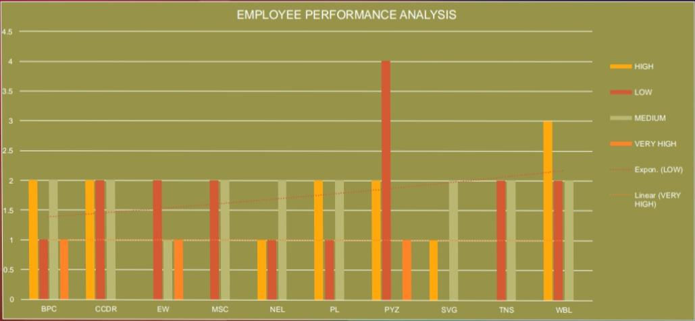
RESULT

Slide 13
CONCLUSION
In conclusion, the Employee PerformanceAnalysis project has provided valuable
insights into the strengths, weaknesses, opportunities, and threats within our
organization. By analyzing employee performance data, we have identified areas for
improvement, optimized performance metrics, and developed targeted training and
development programs. This project will empower the organization to make data-
driven decisions, enhance employee engagement and productivity, and drive
business growth. Ultimately, this project has set a new standard for employee
performance management, positioning the organization for continued excellence and
competitiveness in the industry.

